Slide 1
Training of Model

Slide 2
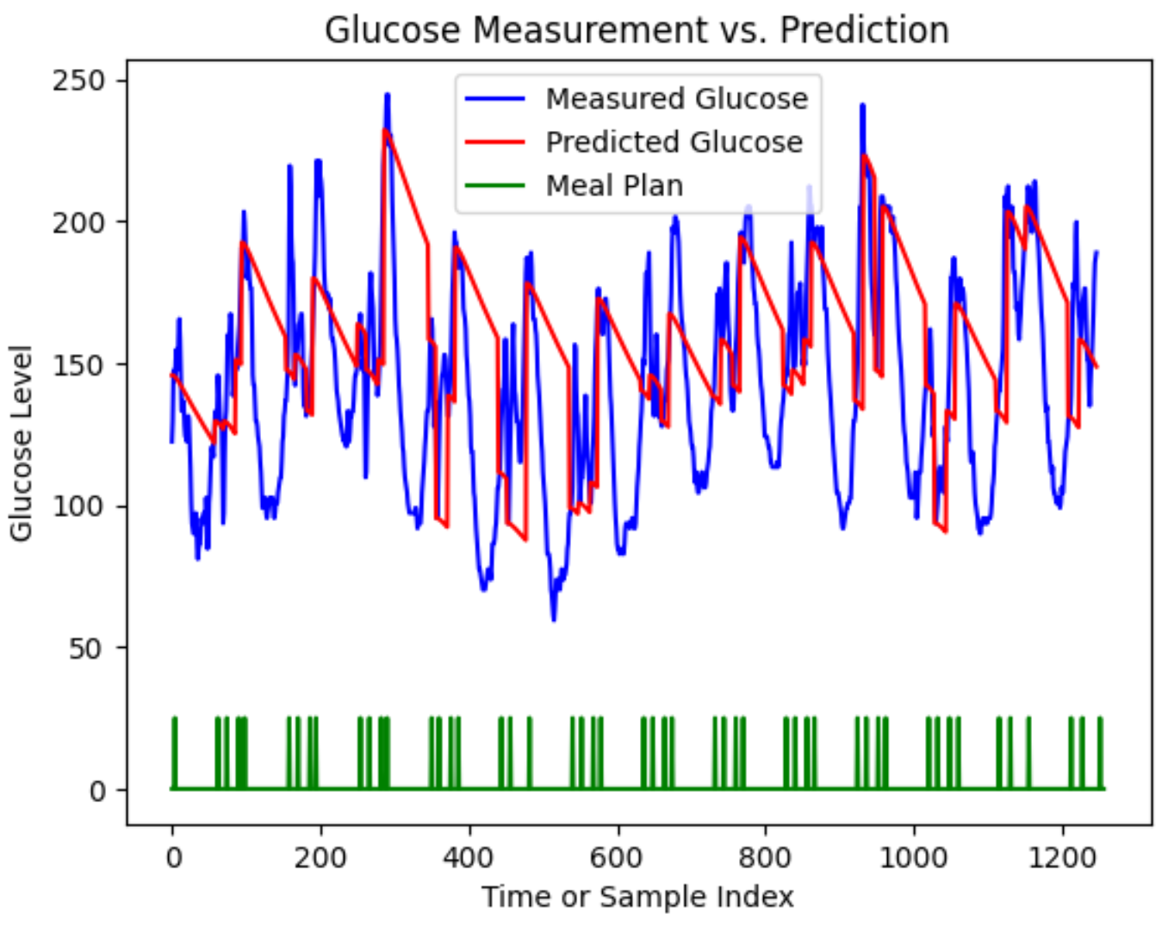
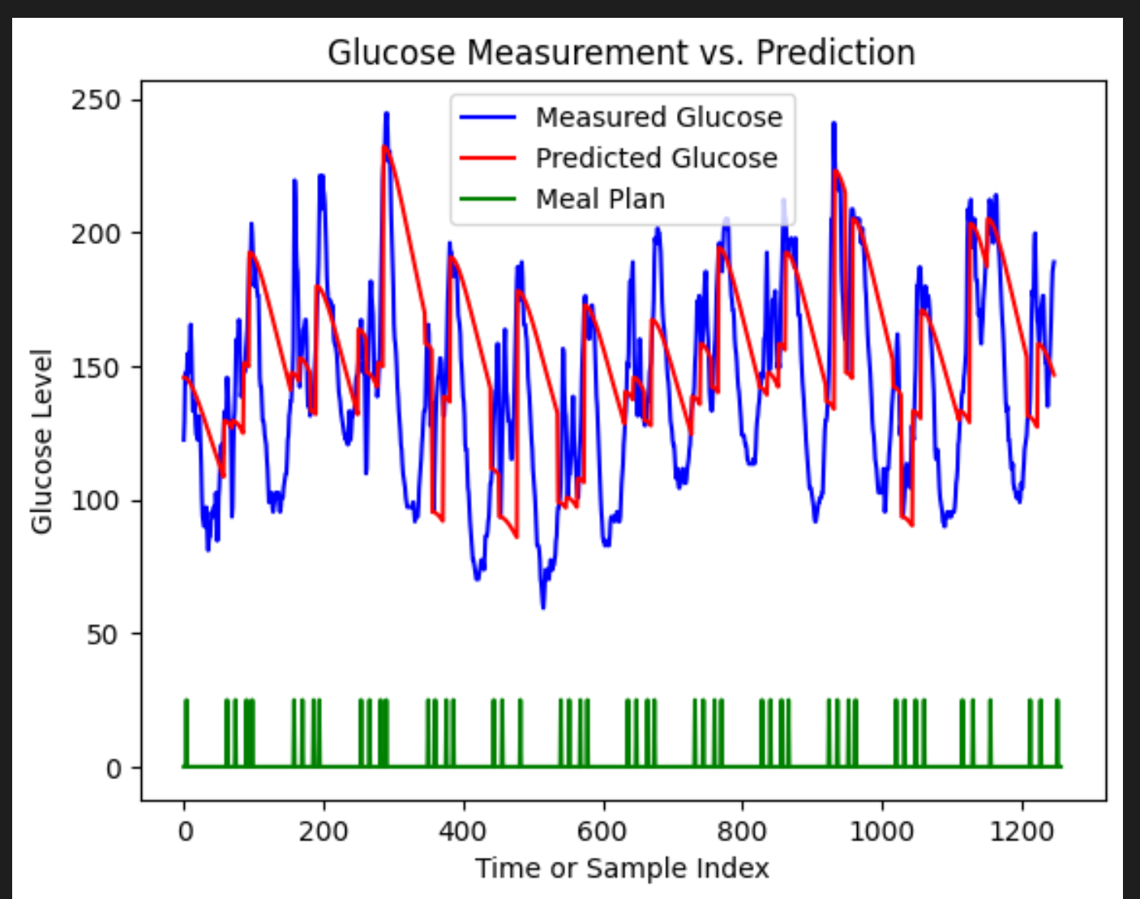
Recall of Problem in last week
The effect of non-insulin medicine
Question:
Since the previous model was proposed many years ago, non-insulin medications may not have been used at that time. Can the effects of non-insulin drugs be added to the original model?
查一下有没有相关的动态模型

Slide 3
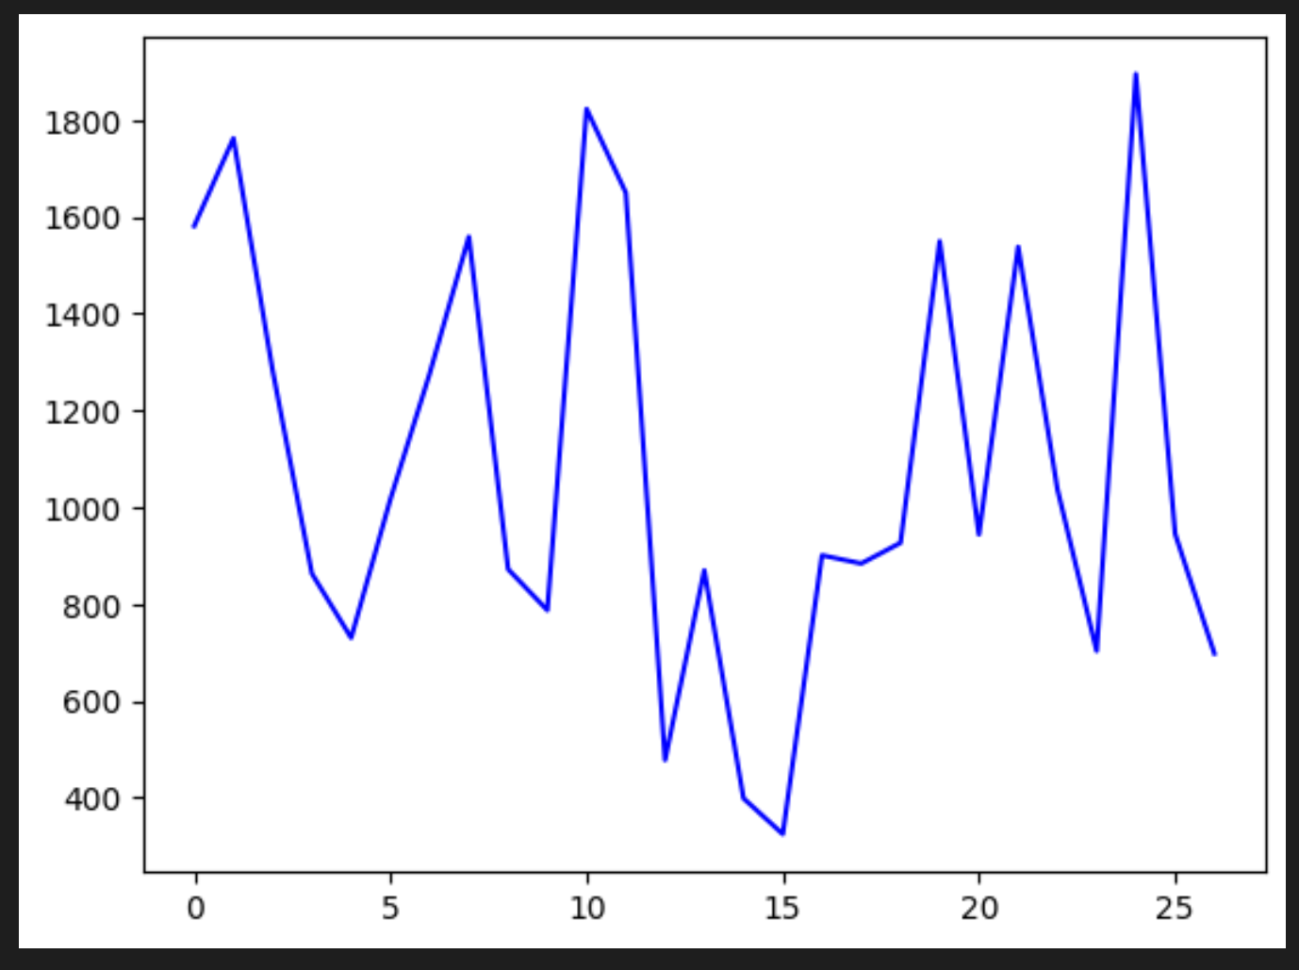
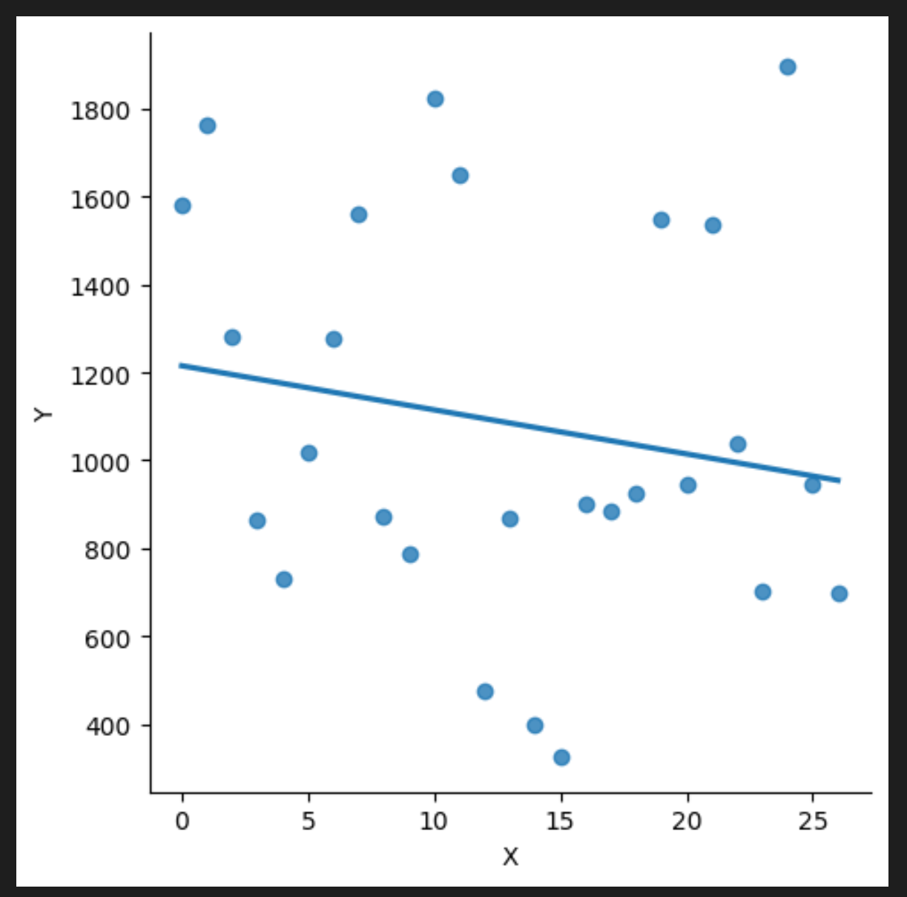

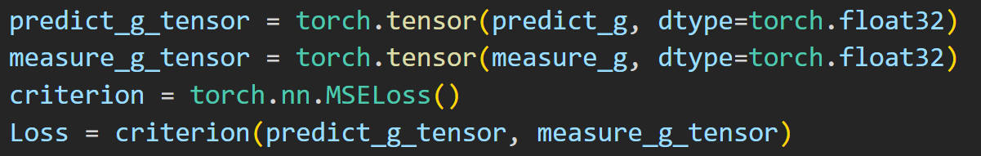
Model Prediction Effect
Loss of Model
Trend of Loss
Problem: 把每个患者的loss相加再优化
The loss is extremely large and doesn’t converge.

Slide 4
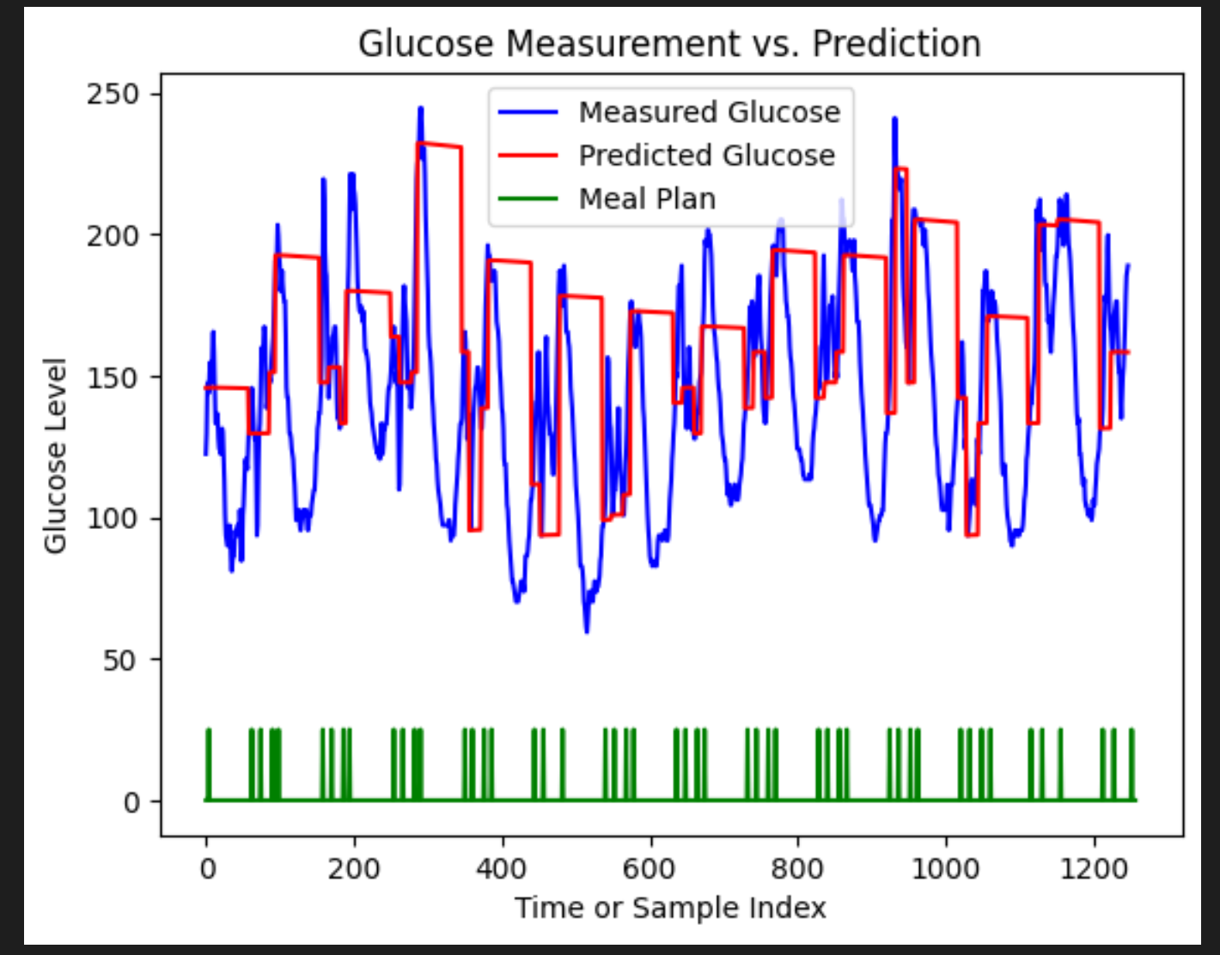
Model Prediction Effect
Initial prediction effect with initial theta
Optimal prediction effect with least loss
Initial theta=[2.404e+01 9.000e+00 6.500e+00 1.800e-01 2.500e-01 1.592e+01 2.300e-03 1.685e+00 3.800e-02 3.150e-05]
Optimal theta=[2.e+01 8.234e+00 0.e+00 1.695e-01 2.295e-01 2.e+00 2.159e-03 1.543e+00 6.261e-02 6.783e-05]

Slide 5
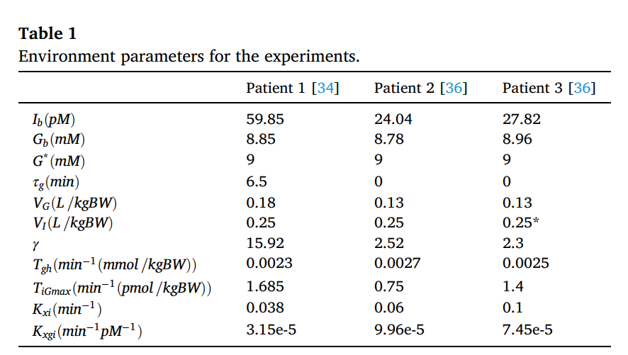
Parameter Comparison
Optimal
theta =
[2.e+01 8.234e+00 0.e+00 1.695e-01 2.295e-01 2.e+00 2.159e-03 1.543e+00 6.261e-02 6.783e-05]

